Slide 1
Micro Project on Frontend Technology
Goindia.com – A Booking Website
- Saili Randive

Slide 2

Content.
HTML .
CSS & Bootstrap.
JavaScript.

Slide 3
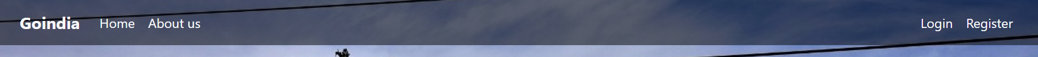
Navigation bar
Home
About Us
Login
Register

Slide 4
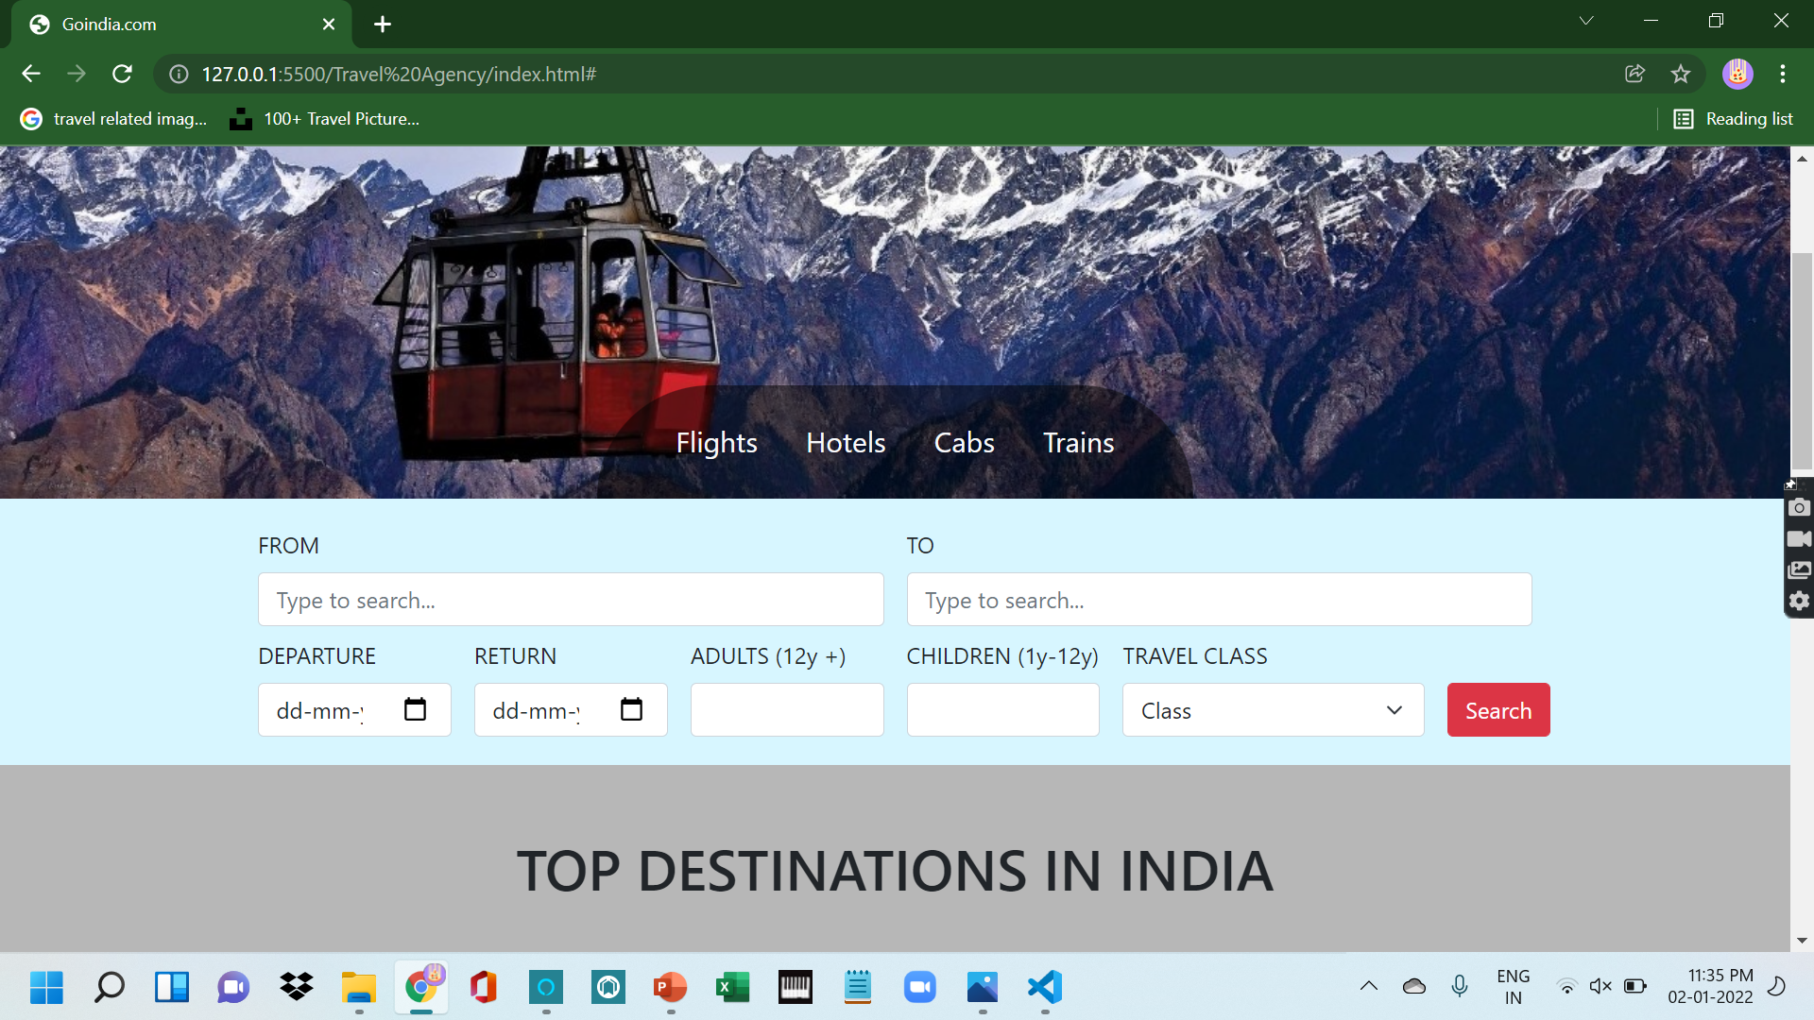
Home page.

Slide 5
Home page consists of Four forms overlapped on the background image.
Flight
Hotels
Train
Cabs

Slide 6
Flight Form.
The flight form is consists of 7 input boxes and 1 button i.e FROM, TO, DEPARTURE, RETURN, ADULTS(12+), CHILDRENS (1Y-12Y), TRAVEL CLASS & SEARCH Button.
From input box is given to search or choose a destination from where a person will depart.
To input box is given to search or choose a destination where a person wants to end the journey.
Departure input box contains a calendar to choose a date of departure.
Return input box also contains a calendar to choose a date to return.
Adult input box is given to choose the no. of tickets a person wants to book.
Children input box is given to choose the no. of tickets a person wants to book for children.
Travel class input box is an input box in which you can choose a class, a person prefers of their choice.
Search button is to check all the availability (meanwhile search button doesn’t work).

Slide 7
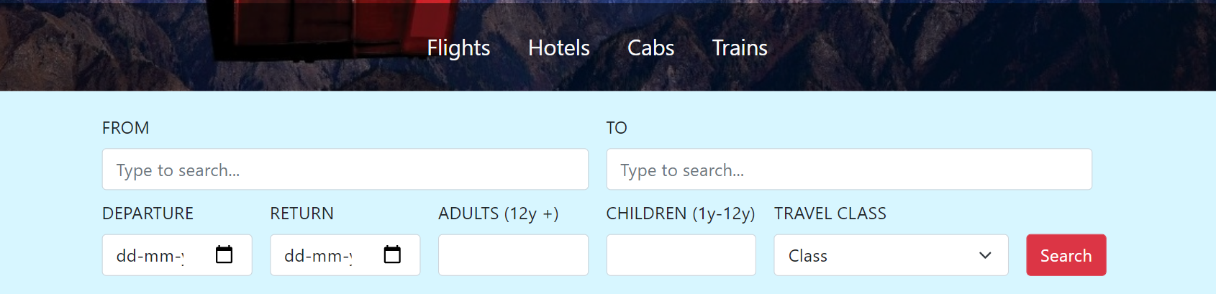
Flight Form

Slide 8
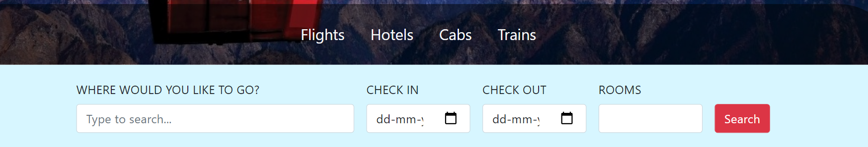
Hotels
The hotel form consist of 5 input boxes and 1 button i.e (Where would you like to go, Check-in, Check-out, Rooms and search button)
Where would you like to go input box helps a person to choose the destination of their choice, this input box contains the selector option of some destination name.
Check-in input box contains a calendar 🗓 to choose a date of checking-in in the hotel.
Check-out input box contains a calendar 🗓 to choose a date of checking-out from the hotel.
Search button is to check all the availability (meanwhile search button doesn’t work).

Slide 9
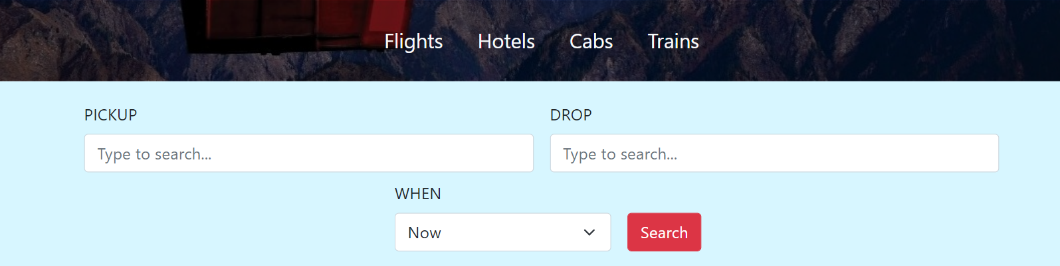
Cabs
The Cabs form consists of 3 input boxes and 1 search button i.e (Pick-Up, Drop, When & search button).
Pick-up input box helps a person to choose the destination of their choice, this input box contains the selector option of some destination name.
Drop input box helps a person to choose the location where they want to end their journey this also contains some selector options of the destination name.
When input box contains 2 options to select the timing of a person ride i.e Now or Schedule for later.
Search button is to check all the availability (meanwhile search button doesn’t work).

Slide 10
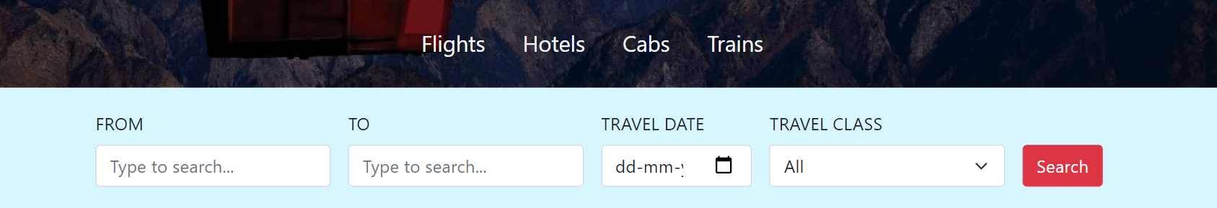
Trains
The Train Form consists of 4 input boxes and 1 button i.e (From, To, Travel date, Travel class & search button.
From input box is given to search or choose a station or city from where a person will catch their train.
To input box is given to search or choose a station or city where a person wants to end the journey.
Travel date input box contains a calendar📆 to choose a date.
Travel class input box is an input box in which you can choose a class, a person prefers of their choice.
Search button is to check all the availability (meanwhile search button doesn’t work).

Slide 11
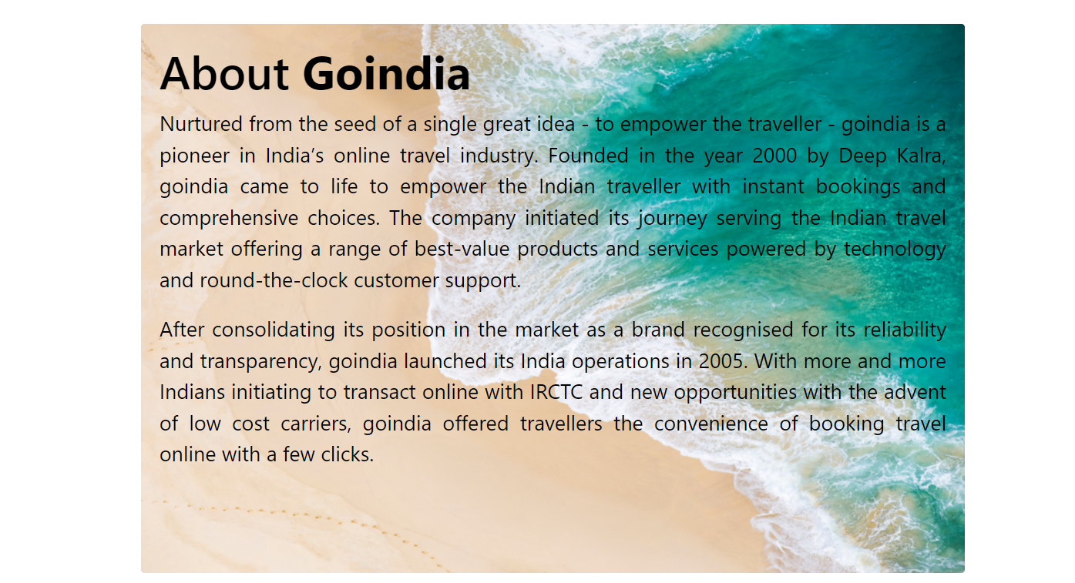
About us.
Description of About us page.

Slide 12
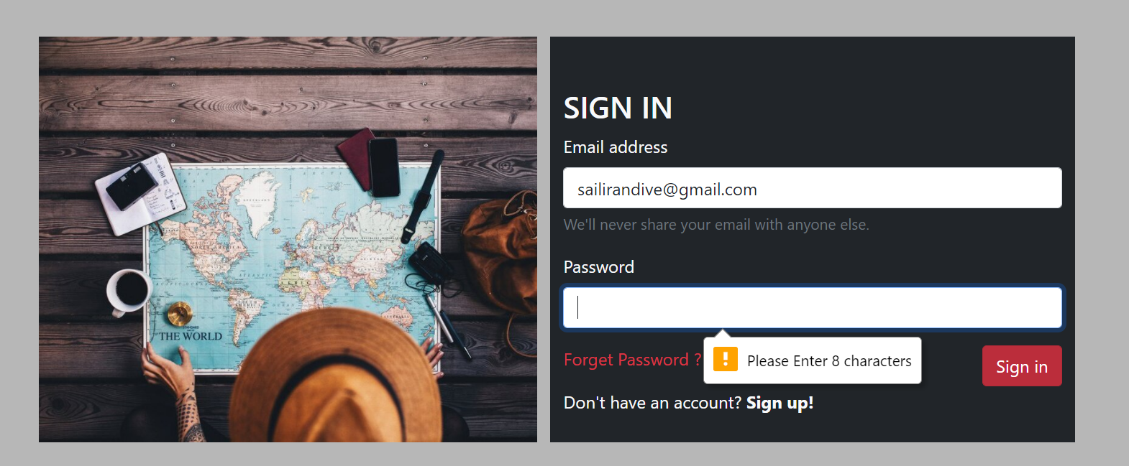
Login Form.
The Login form is a Separate HTML file that is linked to the main file of HTML.
The login form has a side image and the form has a background color.
The login form also has some validations using JavaScript.
If a person clicks on sign up! It will redirect you to the registration form.

Slide 13
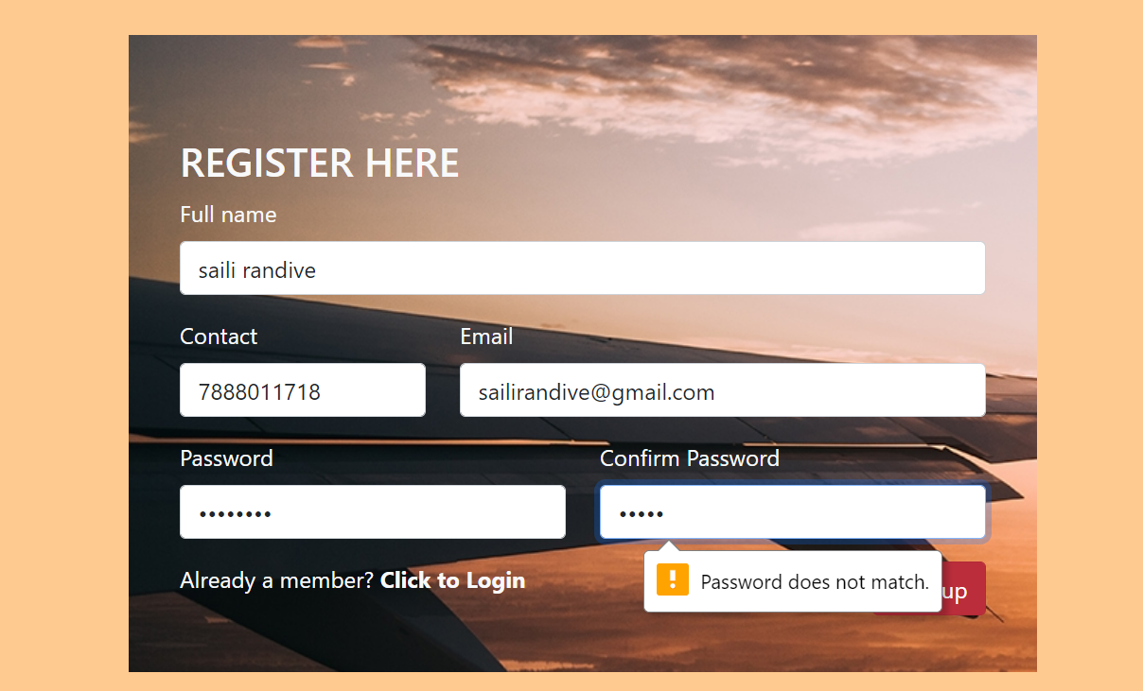
Registration form.
Registration form with some JavaScript validations.
If a person clicks on Already a member? Click to log in will redirect you to a login page.

Slide 14
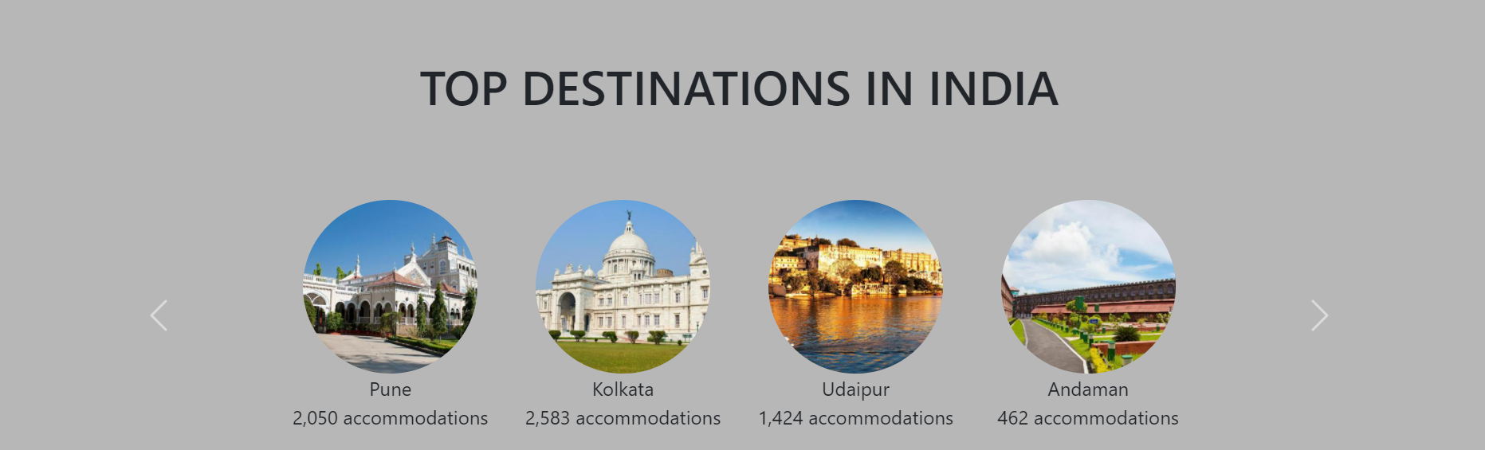
Mid-part.
The mid-part of a website contains carousel slides of Top Destinations in India showing offers and accommodations available in the particular cities.
The carousel slide keeps on changing showing different destinations and their accommodation availability

Slide 15
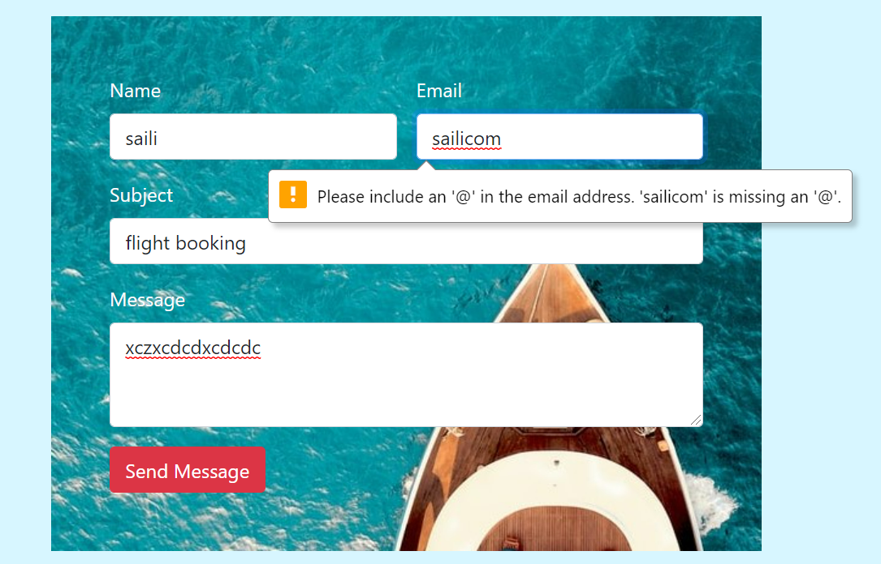
Contact form.
The contact form is named Get in touch, this form is created for customer messages in which they can write or ask whatever they want to ask about booking and this form has some validations using JavaScript.
Validations ℹ
A person has to fill in all the details before clicking on Send Message or else the validation box will pop up saying please fill out this field.
While typing email id if a person forgets to put ‘@’ the box will pop up saying Please include an @ in the email address.

Slide 16
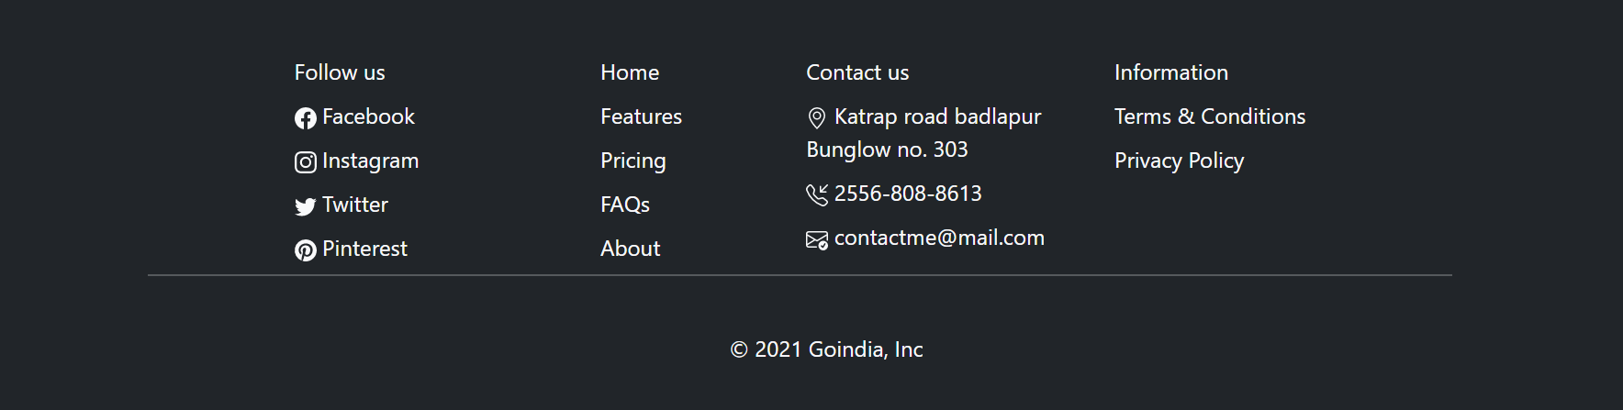
Footer.
The Footer part contains 4 divisions and is in the lists under unordered lists.
Follow us contains social media links
Home
Contact us
Information
At the end of the footer, there is a span tag containing Copywrite symbol with the company name.

Slide 17
Thank you.

